Slide 1
Building Data Warehouse end to end
with Apache Doris
Wandhana Kurnia

Slide 2




About Me
Wandhana Kurnia
Skilled Data Professional with +9 Years Experience to build Data Solution such as DWH, Data Lake, Reporting Regulation, and more for Financial Banking Industry (Indonesia, Philippines).
linkedin.com/in/wandhanakurnia
youtube.com/@wndktech
wandhanak@gmail.com

Slide 3
Introduction to Data Warehousing
Overview of the Technology Stack
Building the Data Warehouse

Slide 4
1
Introduction to Data Warehousing

Slide 5
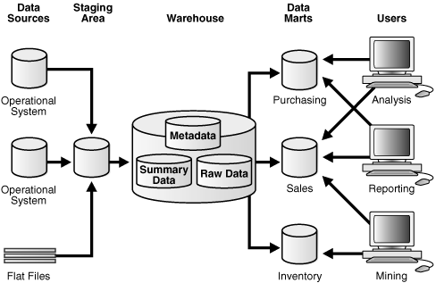
What is a Data Warehouse?
A data warehouse is a type of data management system that is designed to enable and support business intelligence (BI) activities, especially analytics
source: Oracle URL

Slide 6
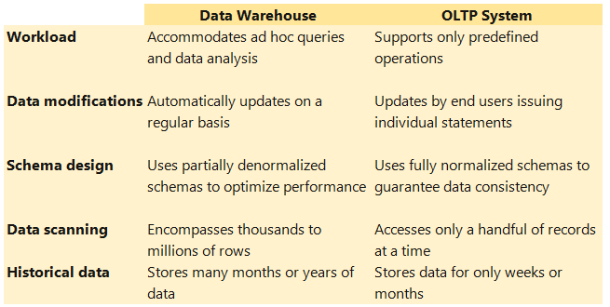
DWH vs Online Transaction Processing System (OLTP)
Data warehouses as OLAP are relational environments that are used for data analysis, particularly of historical data.
In contrast, transactional environments are used to process transactions on an ongoing basis and are commonly used for order entry and financial and retail transactions.
source: Oracle URL

Slide 7
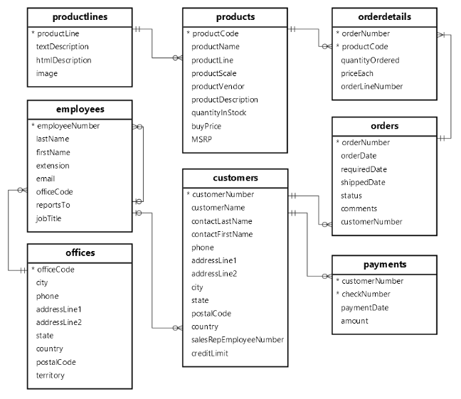
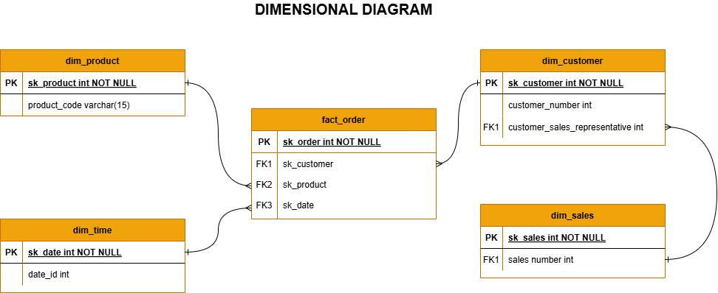
DWH vs OLTP
Normalization
Denormalization
Normalization is used to remove redundant data from the database and to store non-redundant and consistent data into it
Denormalization is used to combine multiple table data into one dimensional model so that it can be queried quickly.

Slide 8
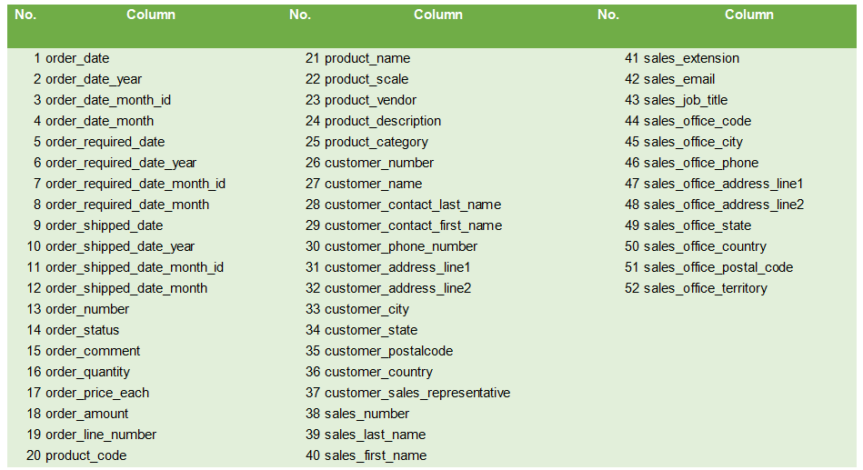
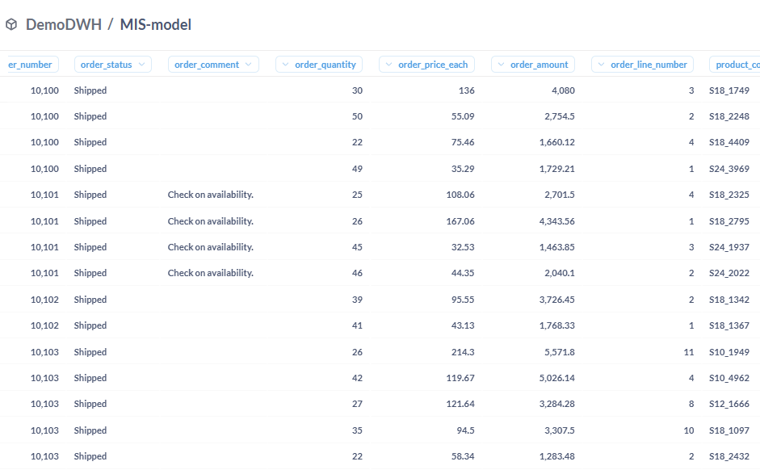
Denormalization Report Model
Enhances Data Warehousing and OLAP Performance
Denormalized schemas, such as star schema or snowflake schema, are commonly used in data warehouses to improve Online Analytical Processing (OLAP).
Star schema (fact tables + dimension tables) is particularly effective for fast queries and reporting.

Slide 9
2
Overview the Technology Stack

Slide 10
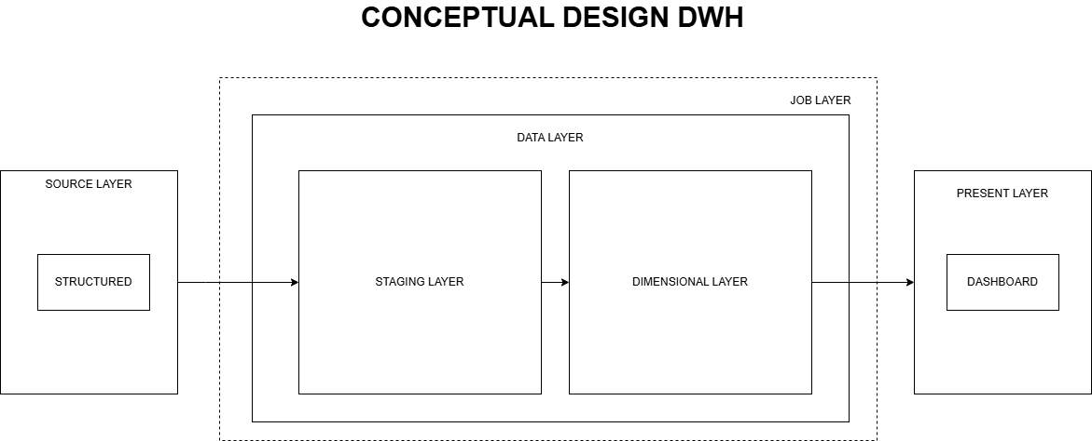
Common DWH Conceptual Design
Source Layer : This is the primary data source where raw transactional data is stored.
Data Layer : This layer is responsible for processing, transforming, and storing data efficiently.
Presentation Layer : Enables business users to visualize and analyze data through interactive dashboards and reports.
Job Layer : Manages and automates the end-to-end ETL process, ensuring smooth data movement between layers.

Slide 11
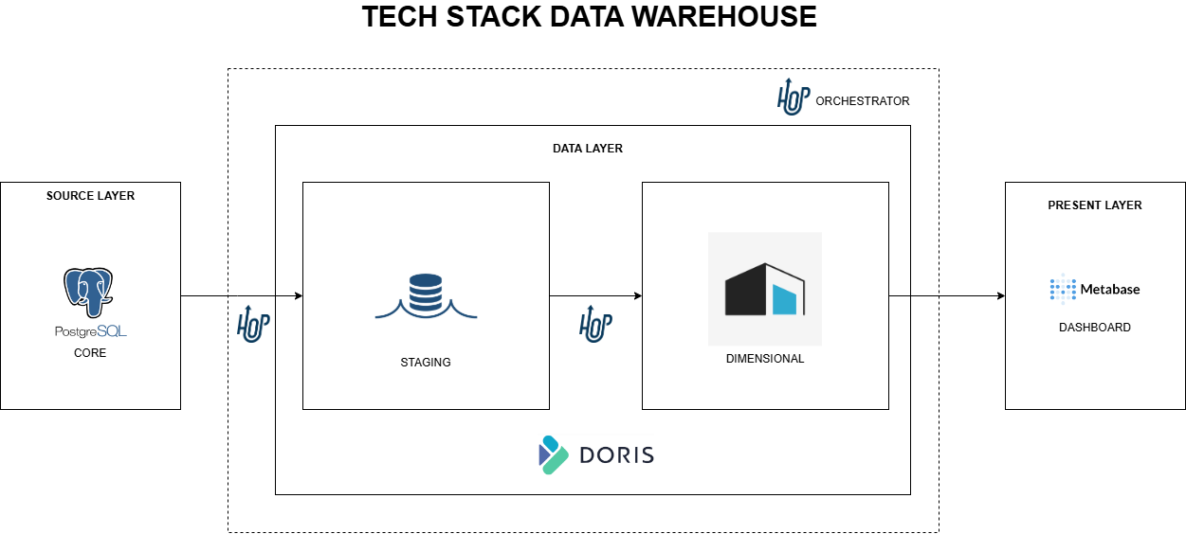
DWH Technology Stack (Demo)
This data warehouse (DWH) architecture follows a structured approach to data processing and analytics using :
Apache Doris as the analytical database
Apache Hop as the ETL and orchestrator
Metabase as the visualization tool

Slide 12

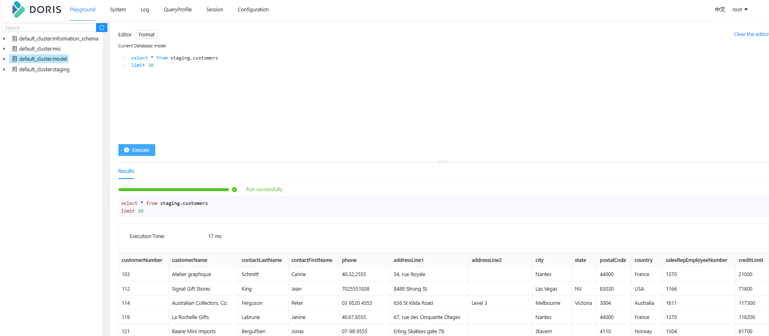
Apache Doris as The Analytical Database
Apache Doris is an MPP-based real-time data warehouse known for its high query speed. For queries on large datasets, it returns results in sub-seconds.
It can be used for report analysis, ad-hoc queries, unified data warehouse, and data lake query acceleration.
Apache Doris is highly compatible with the MySQL protocol and supports standard SQL syntax, covering most MySQL and Hive function
Source: Apache Doris URL

Slide 13

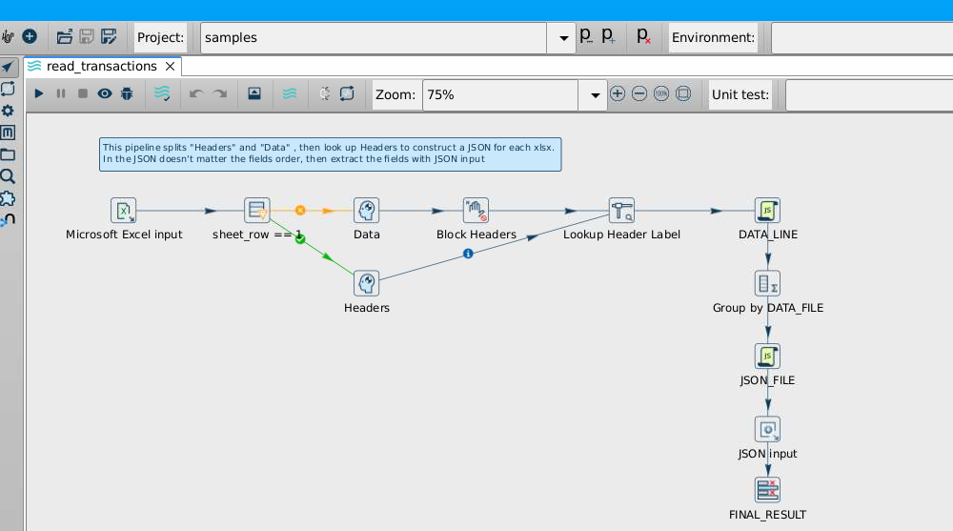
Apache Hop as The ETL & Orchestrator
Apache Hop, short for Hop Orchestration Platform, is a data orchestration and data engineering platform that aims to facilitate all aspects of data and metadata orchestration.
Hop allows data professionals to work visually, Visual design enables data developers to focus on what they want to do instead of how that task needs to be done.
Source: Apache Hop URL

Slide 14

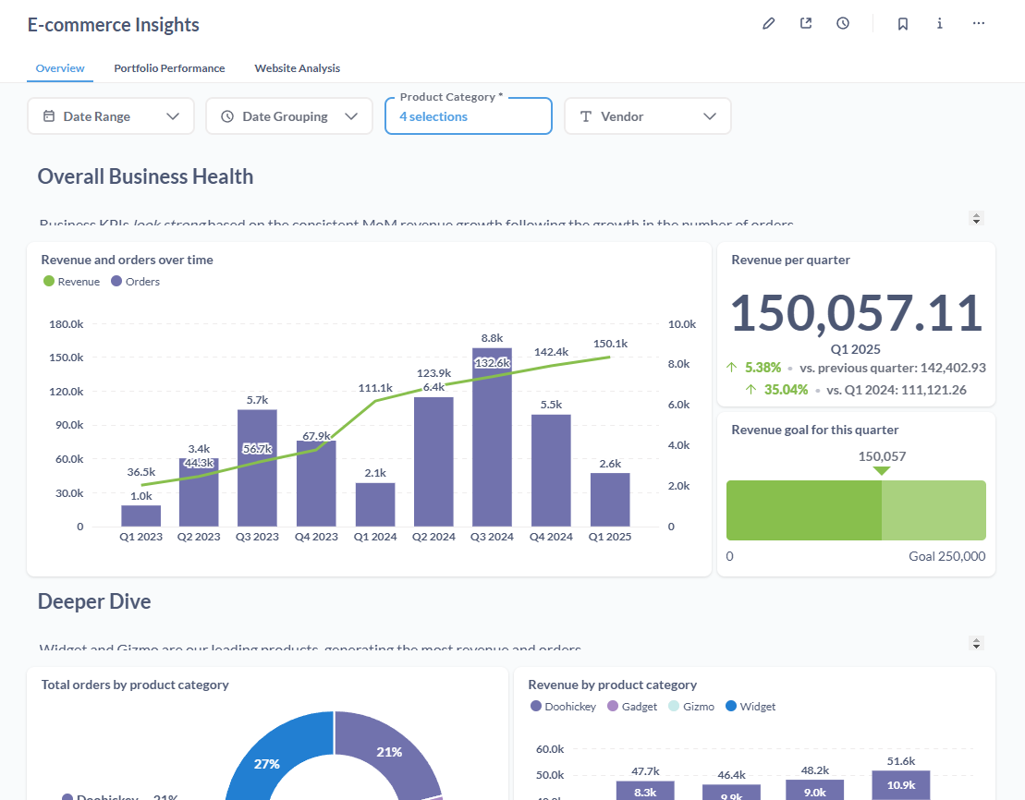
Metabase as Business Intelligence
Metabase is an open-source business intelligence platform. You can use Metabase to ask questions about your data, or embed Metabase in your app to let your customers explore their data on their own.
Fast analytics with the friendly UX and integrated tooling to let your company explore data on their own.
Source: Metabase URL

Slide 15
3
Building the Data Warehouse

Slide 16
Demo

Slide 17
Summary
Completion of Building Data warehouse with following a structured technology approach:
1. OLAP Database – Fast analytical queries making it an ideal choice for the data warehouse & business intelligence in Apache Doris.
2. ETL Process – Extracting, transforming, and loading data efficiently with Apache Hop.
3. Dashboard & Reporting – Visualizing business insights using Metabase
By implementing this demo of data warehouse, businesses can gain faster insights, improve decision-making, and optimize operations.

Slide 19
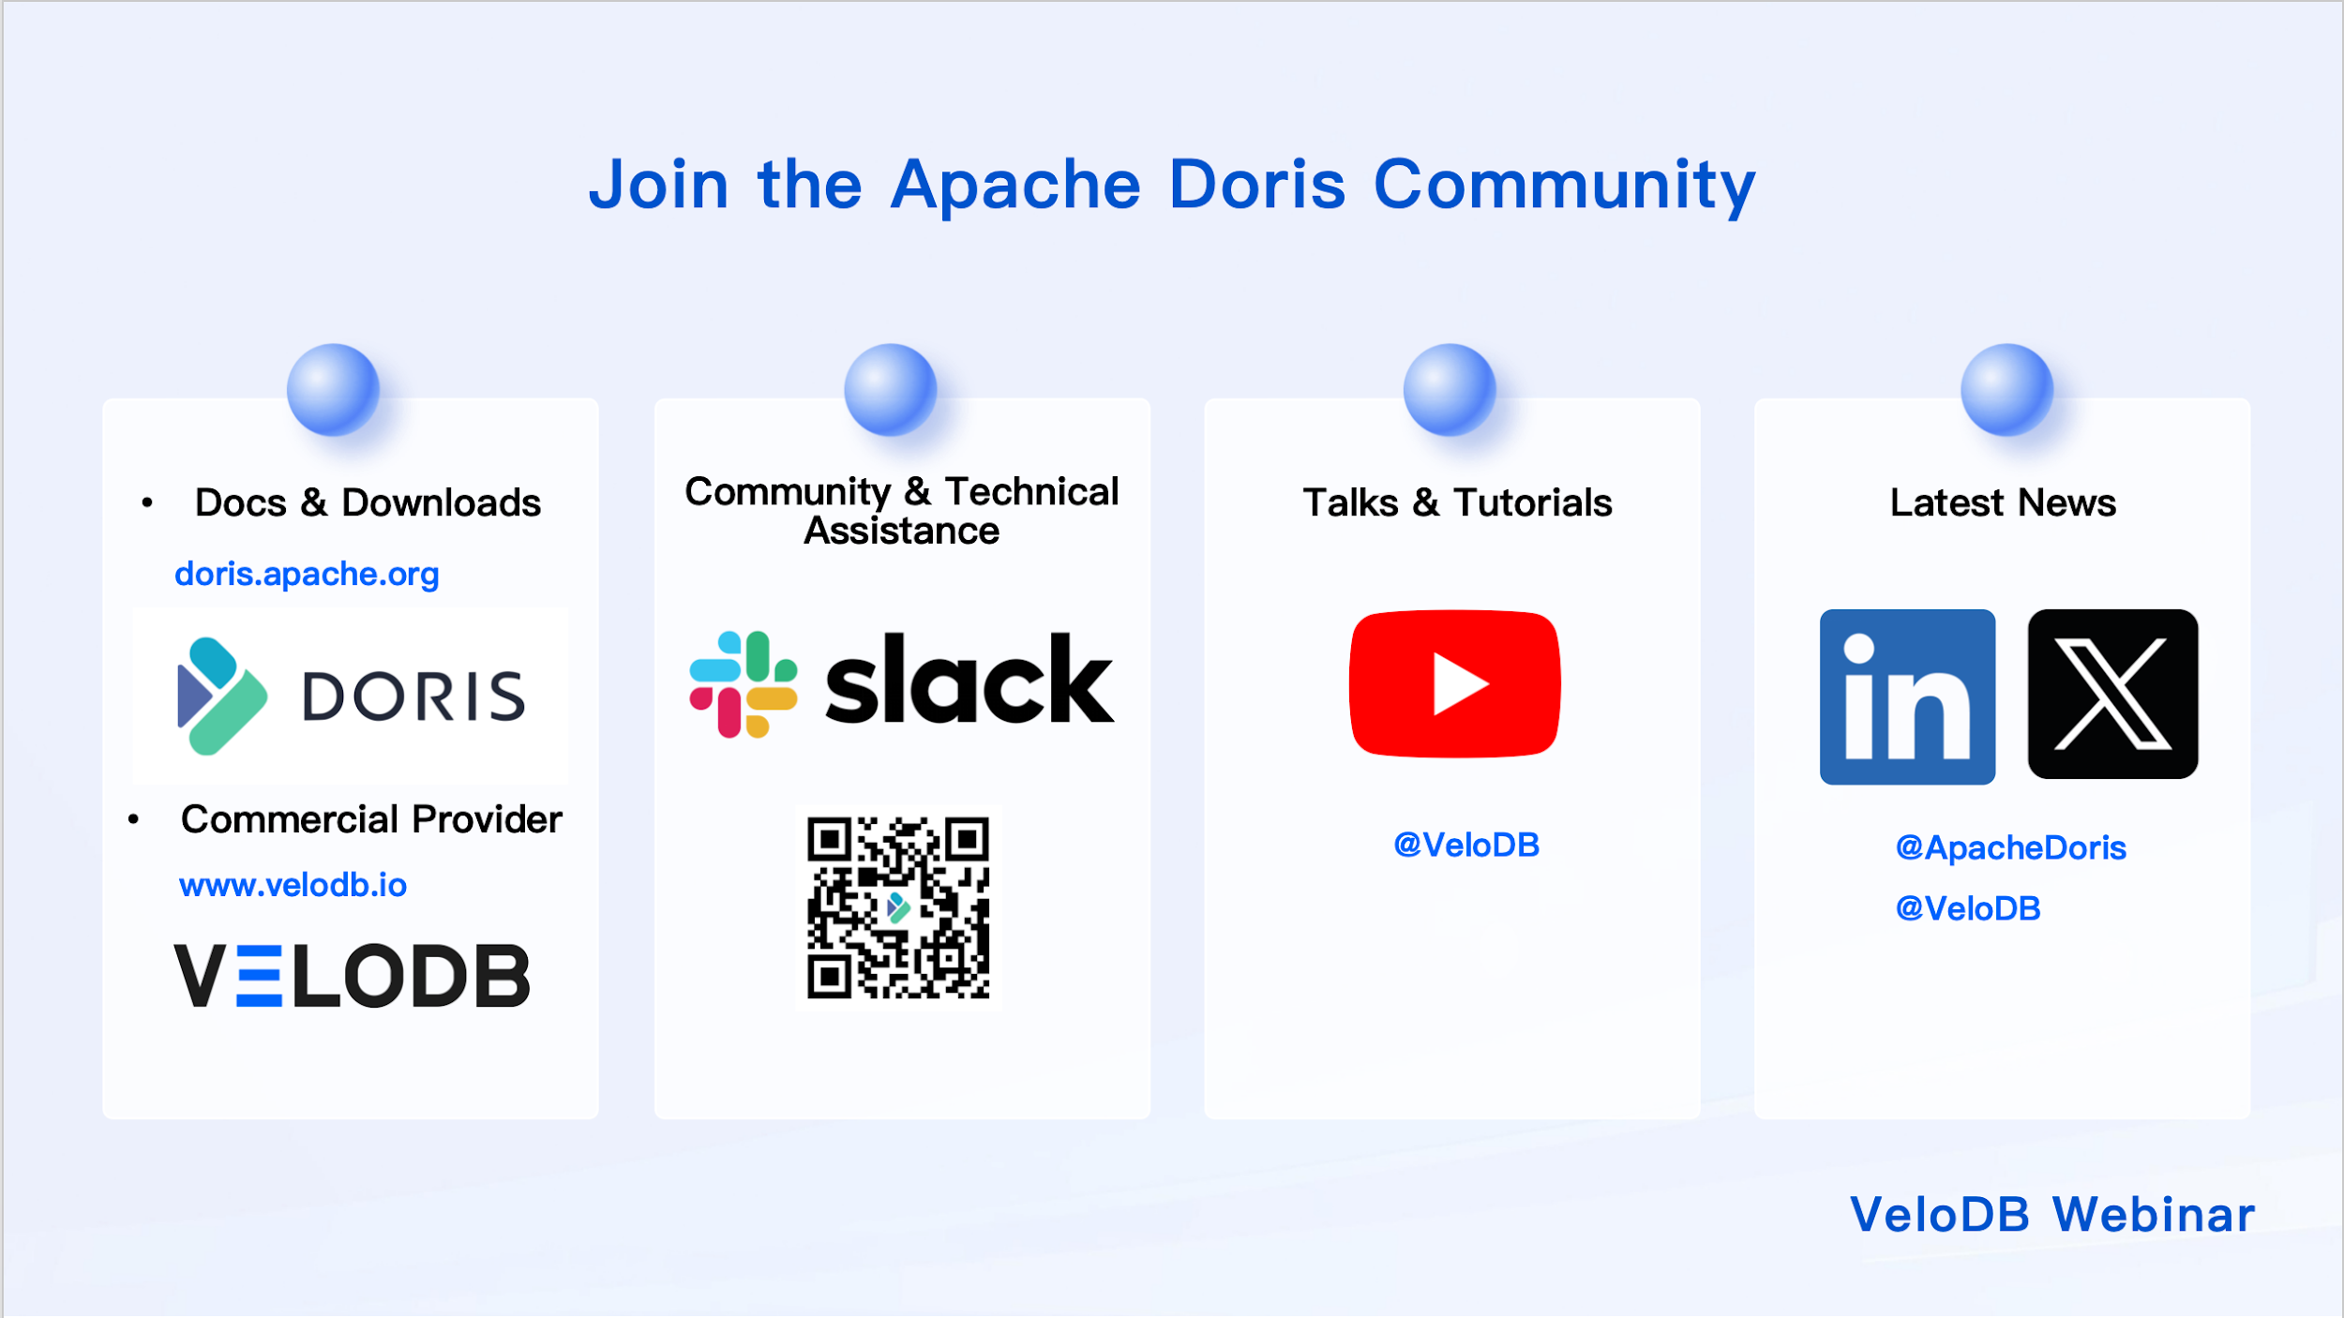

Slide 20
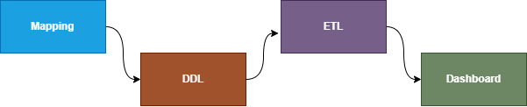
Demo Building The Data Warehouse
Mapping & Business Analysis: Before building the DWH, we need to identify key business questions and reporting needs.
Creating the Data Schema (DDL) : After mapping business needs, execute the DDL schema in Apache Doris
ETL : Perform cleaning, deduplication, aggregation, and denormalization and Load into Dimensional Model using Apache Hop
Creating Dashboard : With Metabase, Build interactive dashboards and reports for business users

